Slide 1

Never Send a Human to do a Machine’s Job:
How Facebook uses bots to manage tests
Roy Williams, Facebook

Slide 3
Never Send a Human to do a Machine’s Job How Facebook uses bots to manage tests
Roy Williams
Engineering Manager

Slide 4
Agenda
1 | Introduction
2 | Testing at Facebook
3 | Robots
4 | Q&A

Slide 5
Introduction Why talk at GTAC?

Slide 6
Introduction
Me!
Engineering Manager of “Product Stability” team at Facebook
2.5 Years as Software Engineer in Test on Google Maps
5 Years as SDET/SDE at Microsoft
I Love Developer Productivity!

Slide 7
Facebook has no Testers, Very Little QA
But Lots of Tests!
Developers own everything about their code.
Developers still care deeply about shipping quality products.
Testing Plan expected for every change.

Slide 8
Testing at Facebook How and Why

Slide 9
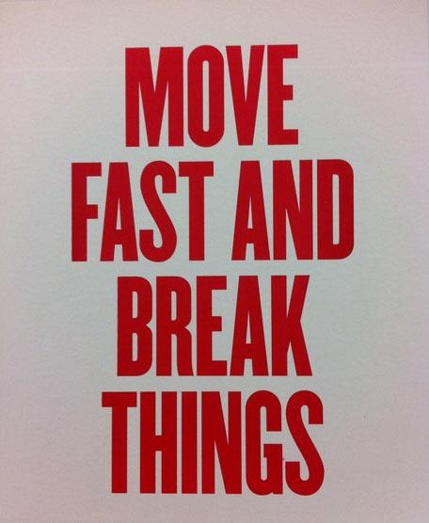
How Facebook Ships
Monolithic Repositories
Website ships twice a day
In mobile:
Android Alpha ships every day
iOS/Android ship every 2 weeks
There is no time for a protracted testing process
Notes:
Everyone should write tests for their own code. Writing automated tests is essential, and we have no QA engineers writing tests for other people’s code.
Product specialists and a small amount of manual testing are a resource, not a replacement for writing tests.

Slide 10
Testing at Facebook - 2009
The genesis
~Hundreds of developers
Complexity starting to exceed point where any one developer can page it into their mind
Developers increasingly blocked on trunk breaks
Too many bugs in production, too much time firefighting

Slide 11
Solution: Automated Testing!

Slide 12
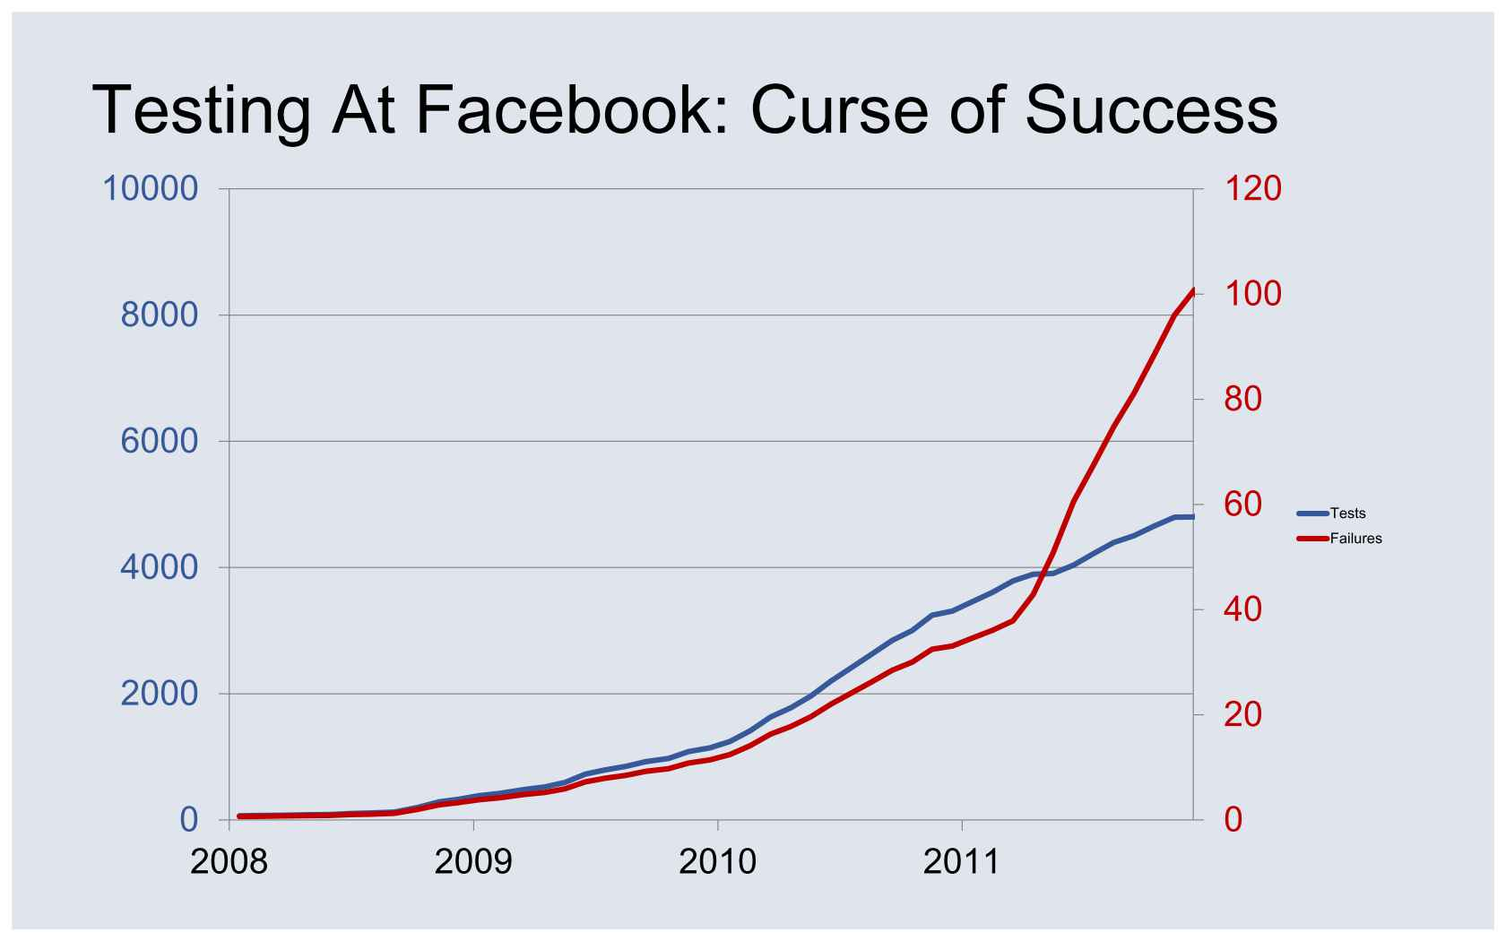

Slide 13
Flaky Tests are POISON

Slide 14
Rise of the Machines

Slide 15

Project Greenhouse
“First, Do No Harm”
Rebuild Trust
Keep tests in a good state without human intervention
Trade machine time for human time

Slide 16
Project Greenhouse
Cull bad tests
Reduce Noise
Automatic Task Management

Slide 17
Test Lifecycle
PassBot
GreenWarden
Unknown Test Quality
Failing
Test
FailBot
TestWarden
Good Test!
FailBot
PassBot
Disabled Test
Disabled Runs

Slide 18
Bots and Wardens
Name | Job
TestWarden | Stress tests tests of unknown quality Files tasks for Bad Tests
FailBot | Disable tests failing for > 1 week File Tasks for Failing Tests Hide failing tests from blocking other developers
PassBot | Run failing tests on a continuous basis Close tasks associated with failing tests
GreenWarden | Identify flaky tests and send then back to TestWarden
Disabled Runs | Re-run disabled tests periodically Re-enable any tests that seem to be continually passing Files task to delete tests that have been disabled for > 1 month

Slide 19
Within each test run
Debug for the developer
Run Tests against diff
retry_count times
Run against merge base
retry_count times
Run against diff
Footnote: Facebook Internal Data, March 2007

Slide 20
Managing Tests with no authority
Developers aren’t the jerks, bots are!
Filing tasks, sending email on failure isn’t enough
All tests need owners, if we fail to blame a revision

Slide 21
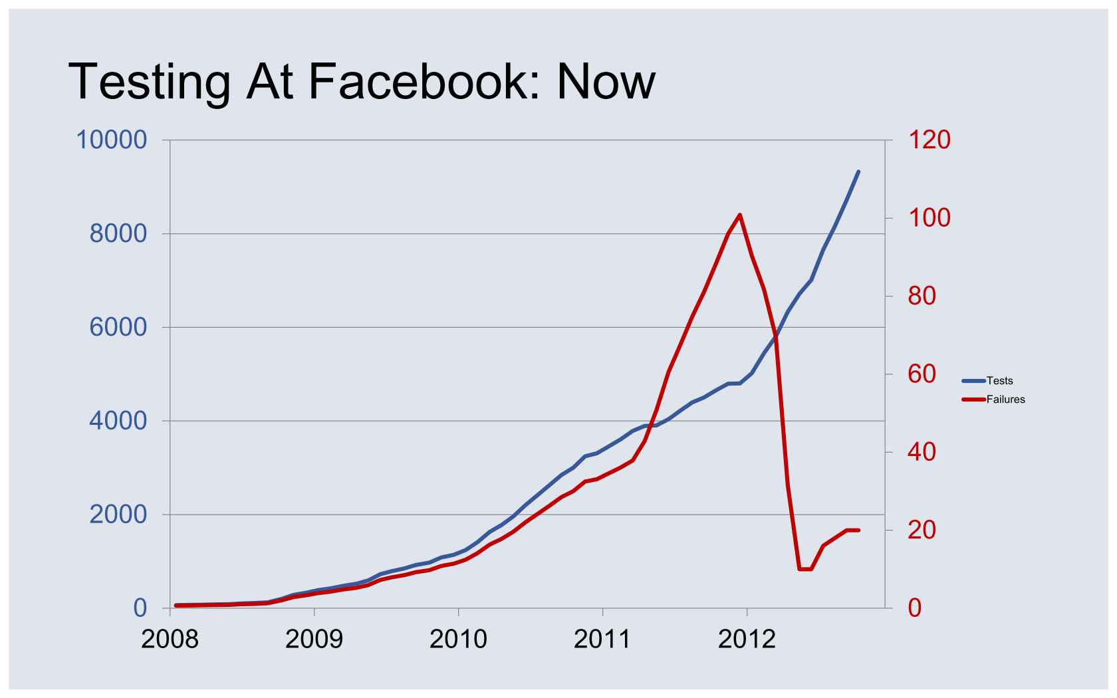

Slide 22
Questions ? How do you manage tests?

